Slide 1
SOUTH CHINA SEA
AND ONE BELT ONE ROAD INITIATIVE:
HOW TO LINK THEM
Amb. Dr. Nguyen Ngoc Truong,
President,
Center for Strategic Studies
and International Development, Viet Nam

Slide 2
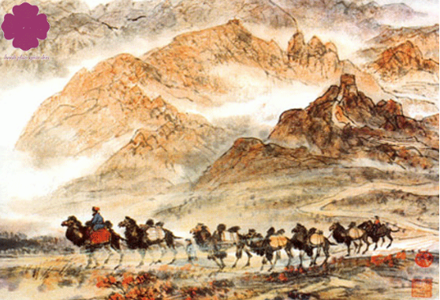
“Actually there is no way, go person many, also then became road” (Lu Xun)

Slide 3
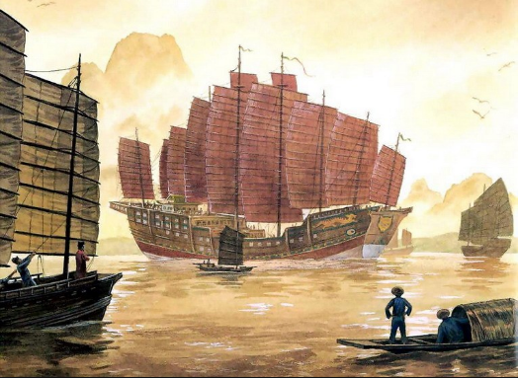
Maritime Silk Road

Slide 4
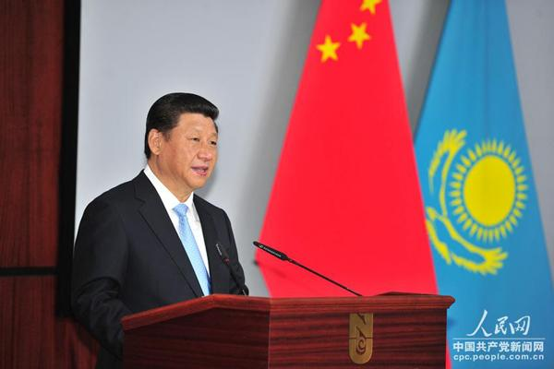
President Xi proposes a “New Silk Road” at Nazarbayev University (Kazakhstan)

Slide 5
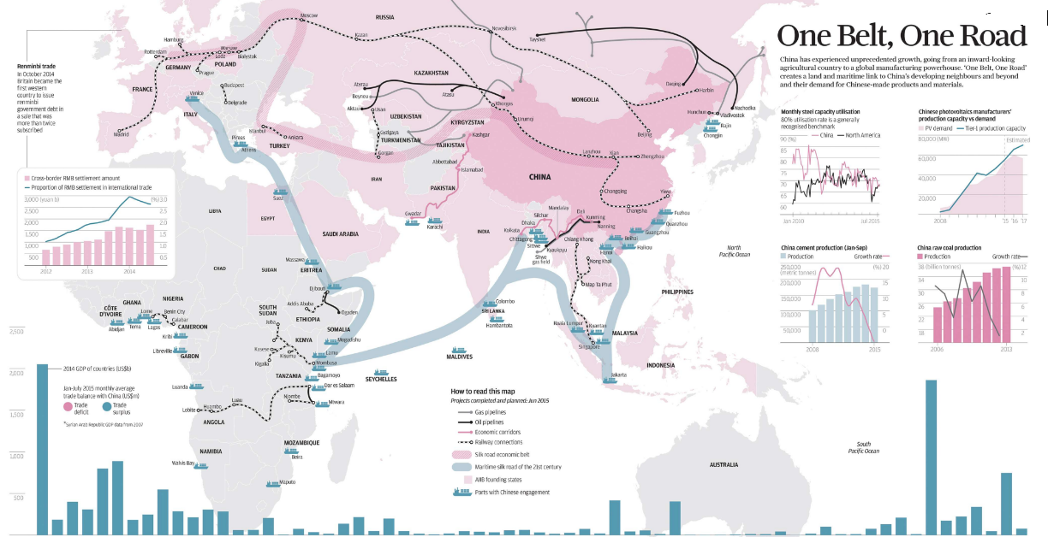
ONE BELT, ONE ROAD

Slide 6
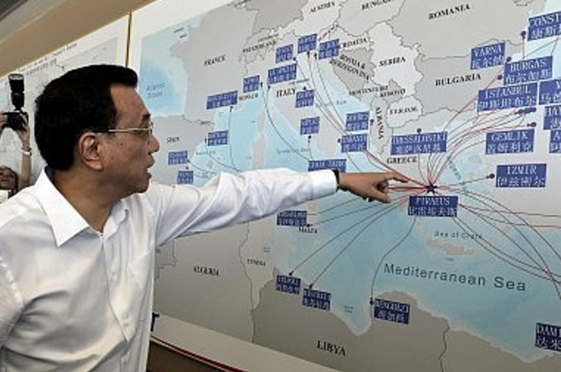
PM Li Keqiang visits Piraeus Port (Greece) in 2015

Slide 7
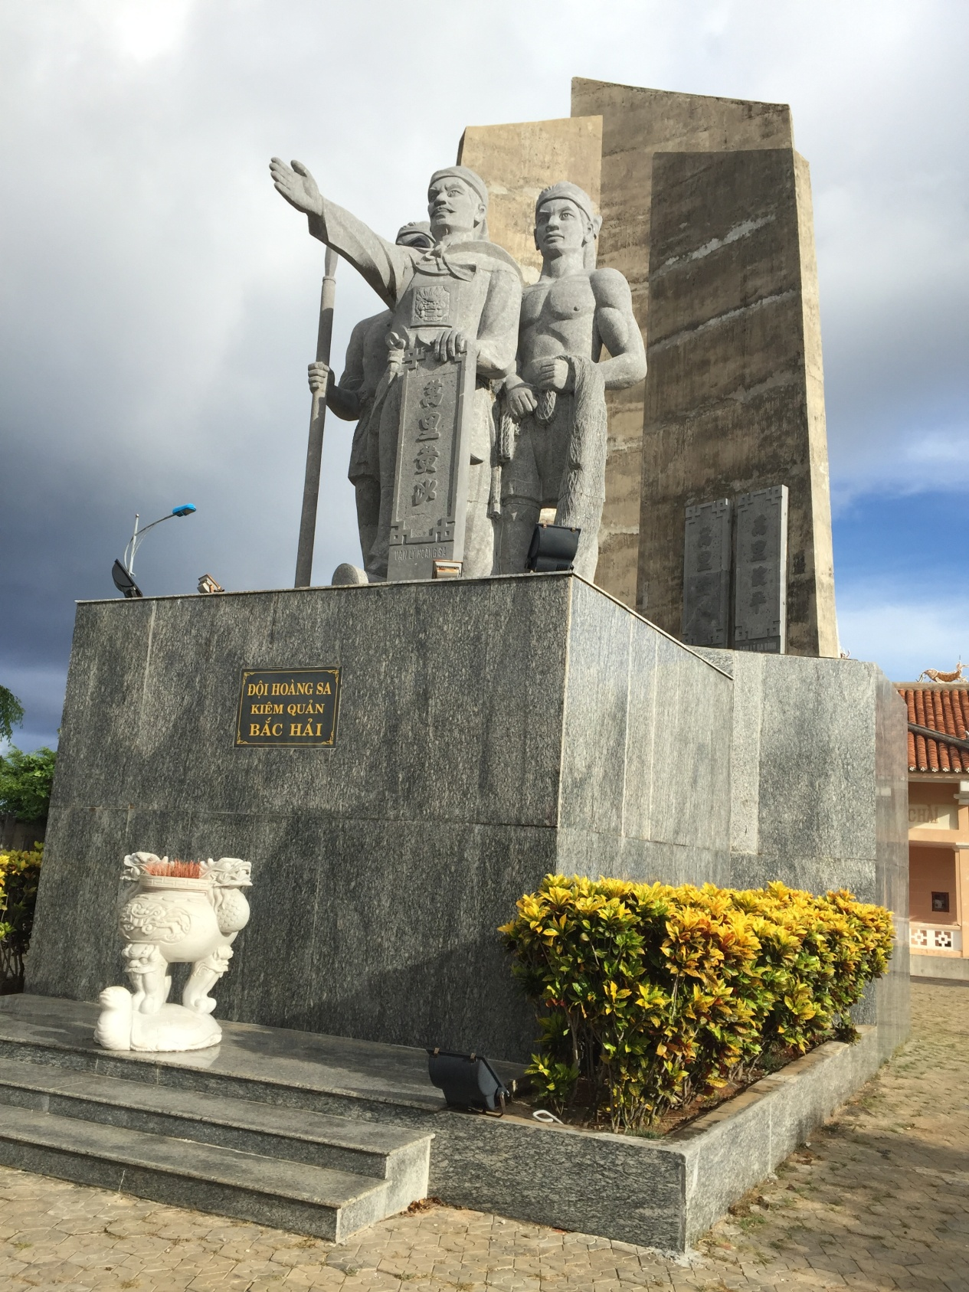
Statue of “Paracel Team” on
Ly Son Island

Slide 8
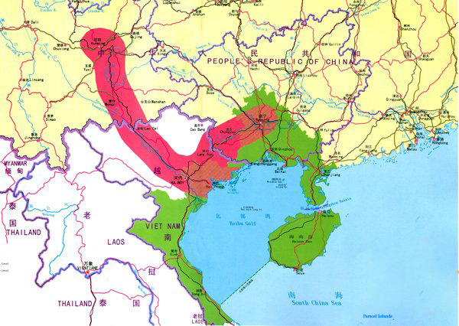
Two Corridors, One Economic Belt
(Vietnam – China)

Slide 9
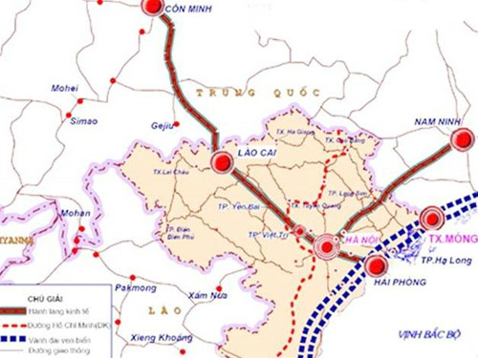
Two Corridors, One Economic Belt
(Vietnam – China)

Slide 10
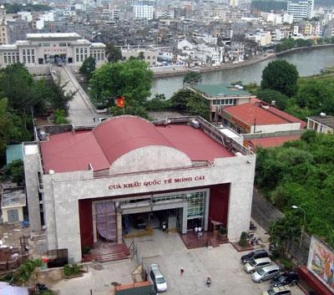
Mong Cai Border Gate with China

Slide 11
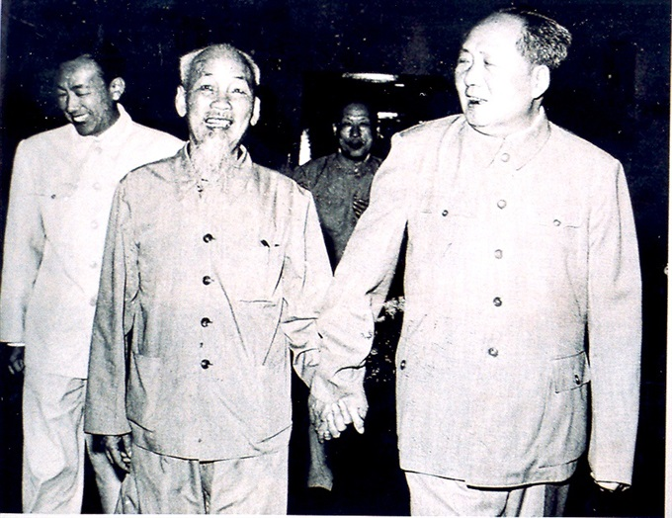

Slide 12
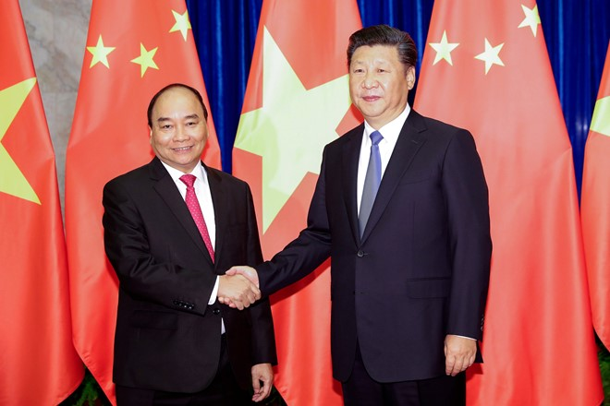
In September 2016, two countries agreed to conduct connection feasibility studies of OBOR and “Two Corridors, One Economic Belt”.

